Slide 1

Data Import

Slide 2
Finding Data
Built-in Datasets in R Packages
Example: NYC Flights
5 Different Data Sets
More Comprehensive List
Vincent Arel-Bundock
Link
Packages
Data Name
Variable Information
CSV Links for Download
DOC Links for Details
>library(nycflights13)

Slide 3
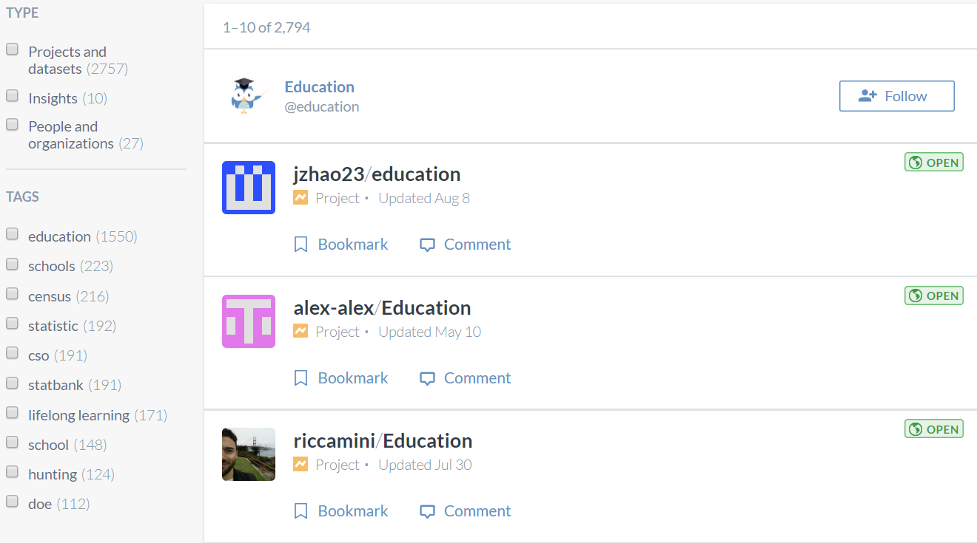
Finding Data
Online Websites
Data.World
Requires Sign-up
Search for Topic

Slide 4


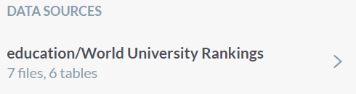
Finding Data
Online Websites
Data.World
Select Projects/Datasets
Check Users

Slide 5
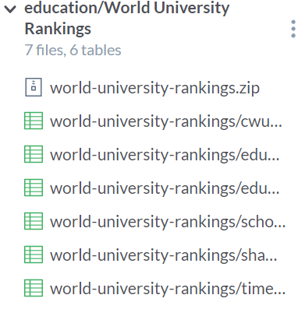
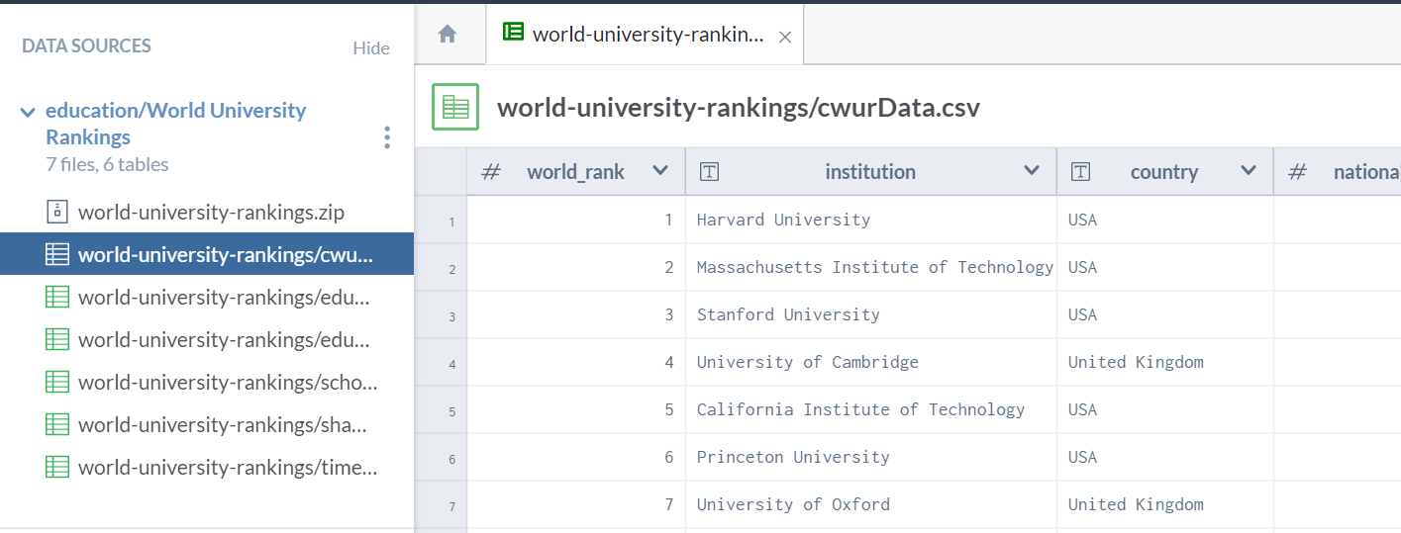
Finding Data
Online Websites
Data.World
Inspect Data

Slide 6
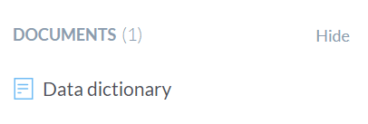
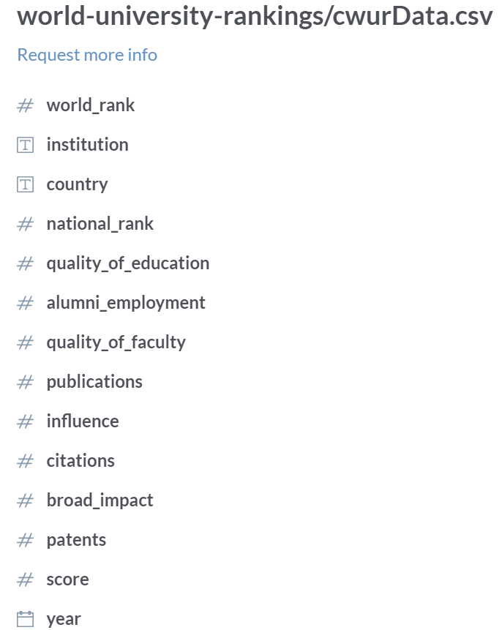
Finding Data
Online Websites
Data.World
Read Data Dictionary

Slide 7
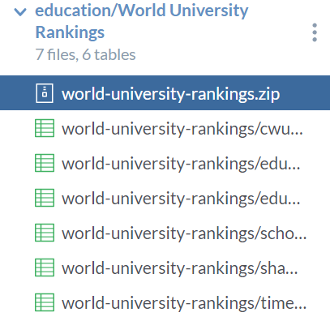
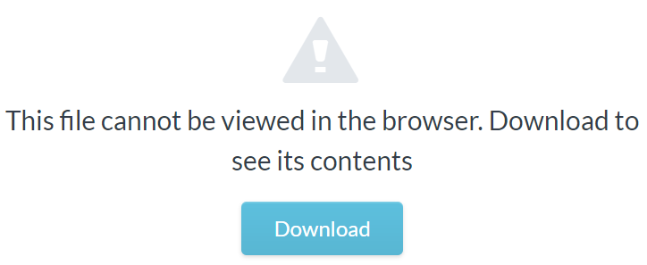
Finding Data
Online Websites
Data.World
Download .zip Folder

Slide 8



Finding Data
Online Websites
Data.Gov
Logo… So Hot Right Now
Topics List

Slide 9
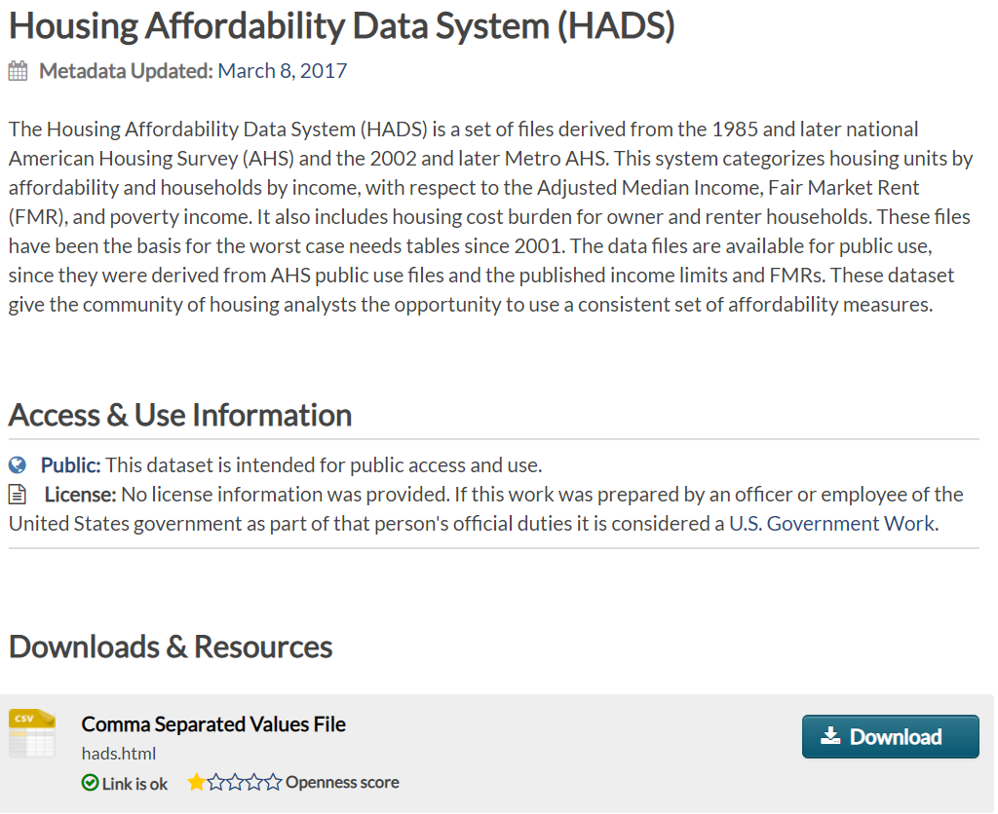
Finding Data
Online Websites
Data.Gov
Check Description

Slide 10
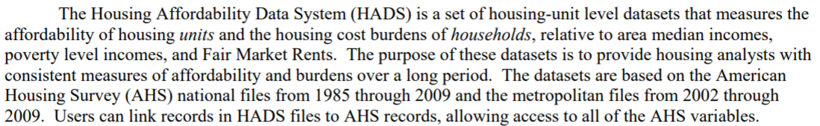
Finding Data
Online Websites
Data.Gov
Find Documentation
Important Info About Data
Purpose of Data
Survey Data
Two Sets of Files
Years Included

Slide 11
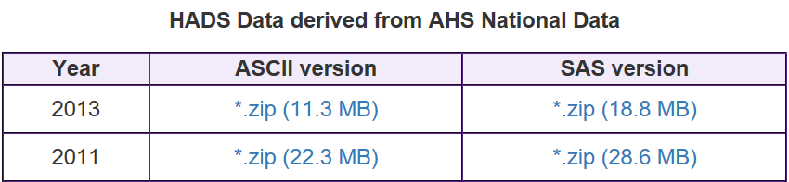
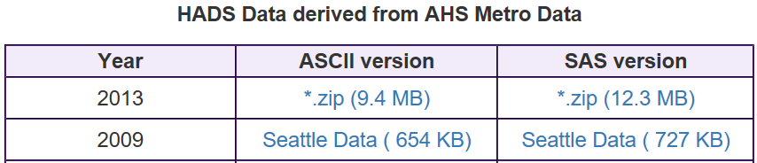
Finding Data
Online Websites
Data.Gov
Download Links

Slide 12
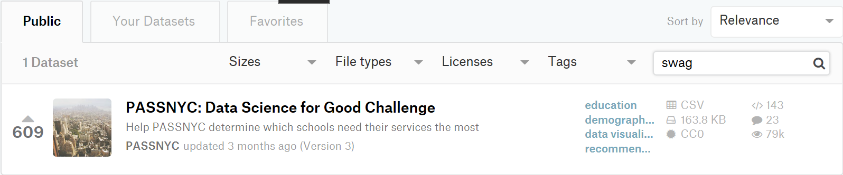
Finding Data
Online Websites
Kaggle
Requires Sign-up
Check Datasets

Slide 13



Finding Data
Online Websites
Kaggle
Requires Sign-up
Overview and Question

Slide 14

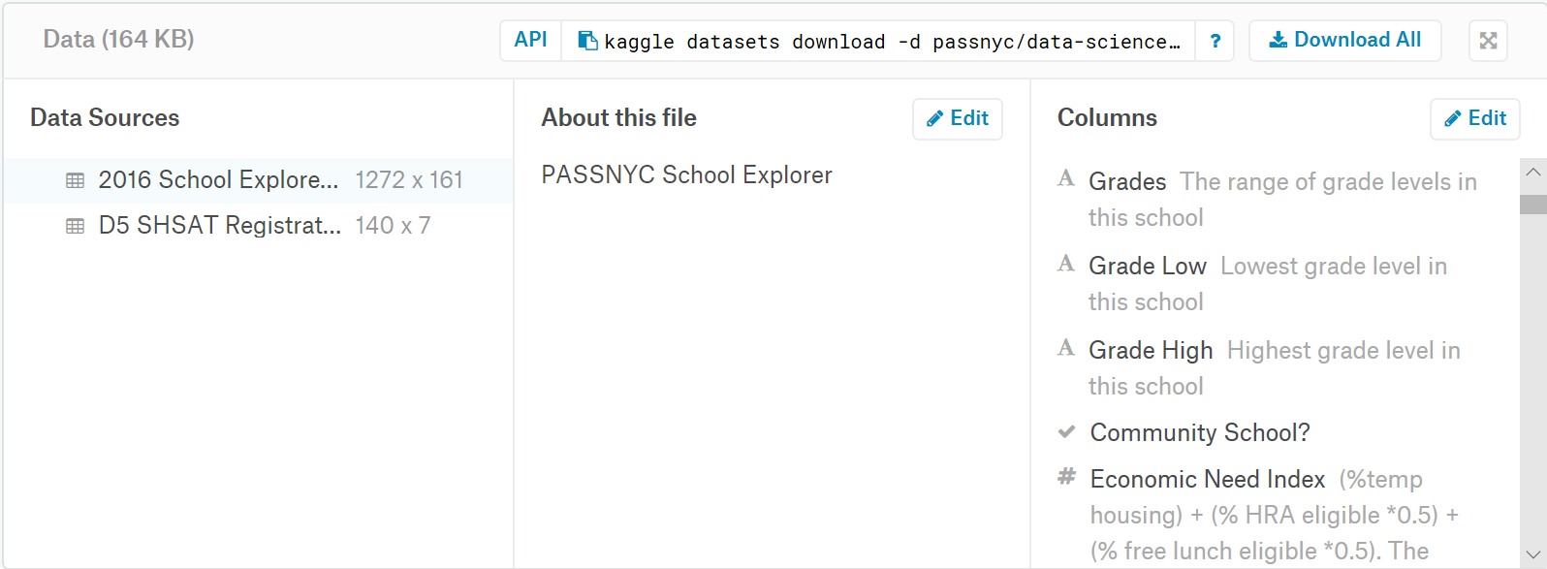
Finding Data
Online Websites
Kaggle
Requires Sign-up
Data Info and Download

Slide 15
File Types
Read Chapter 8
Package for Importing
Functions for Loading Data
File Types
Different Delimiters
Comma, Tab, Space, Semicolon, Period
Different File Types
CSV – Comma
XLSX or XLS – Tab
TXT – Anything Possible
HTML – Anything Possible
Inspect Raw Data File
>library(readr)

Slide 16
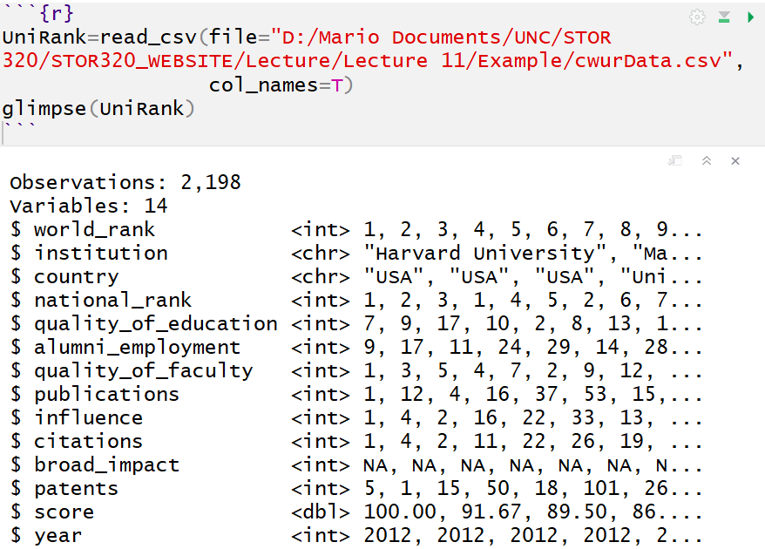
Data Import
Importing CSV – Most Common
read_csv()
File Path Requires “/”
Auto Use of Column Names
Autodetects Variable Types

Slide 17
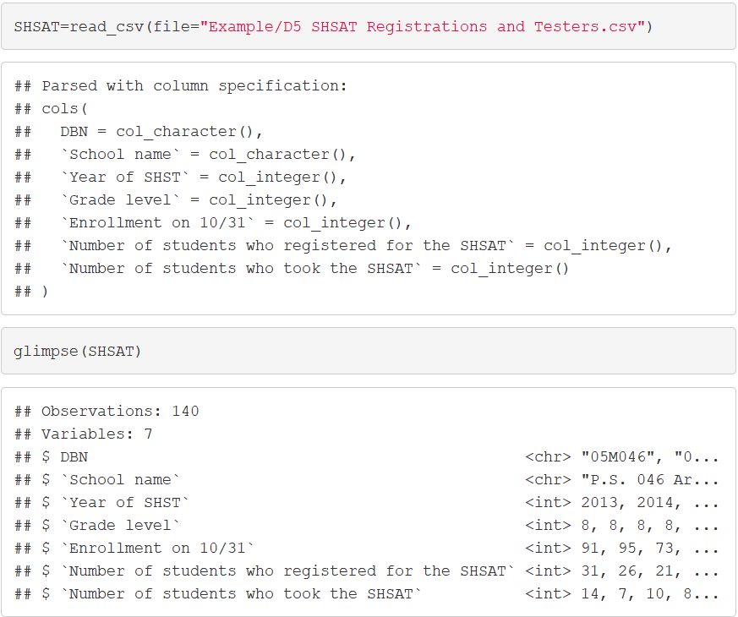
Data Import
Importing CSV – Most Common
Autodetect Info

Slide 18
Data Import
Other Types
read_delim() for General
XLS or XLSX
Always Check Tibble After Import
Observe That Variable Types are What You Want
Check Missing Values
See if NA’s are Appropriately Recorded
Too Many NA’s
Not Enough NA’s
Crosscheck Raw Data and Data Documentation
>library(readxl)

Slide 19
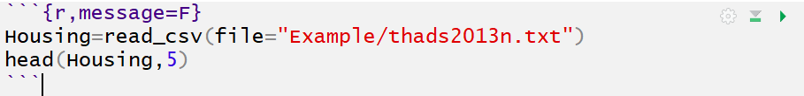
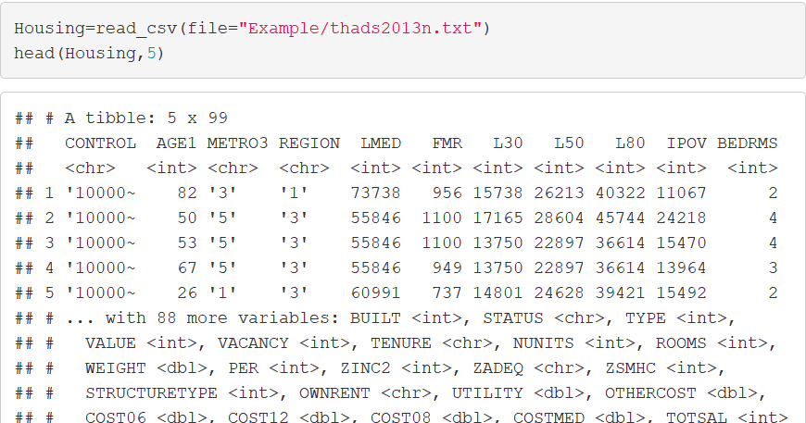
Example
HADS Data From Data.Gov

Slide 20
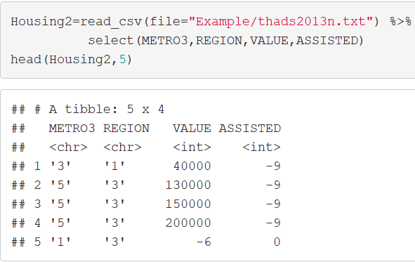
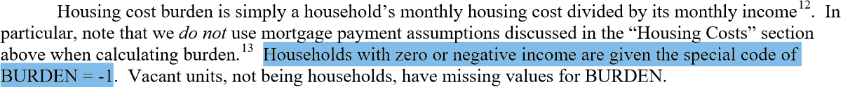
Example
HADS Data From Data.Gov
Errors or Missing
Should Become NA

Slide 21
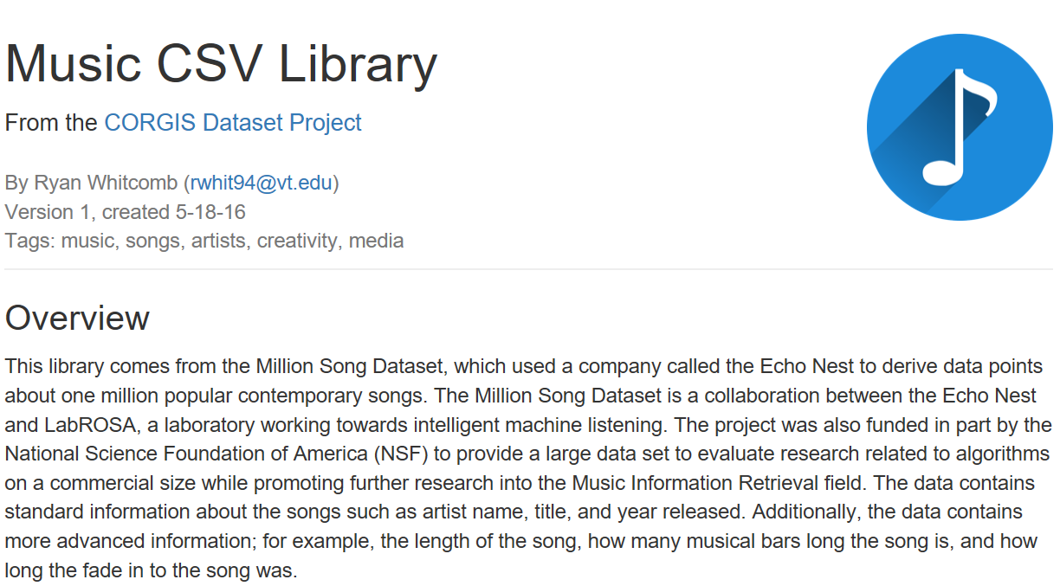
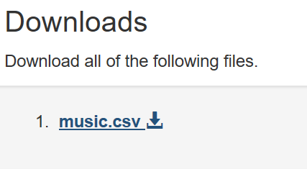
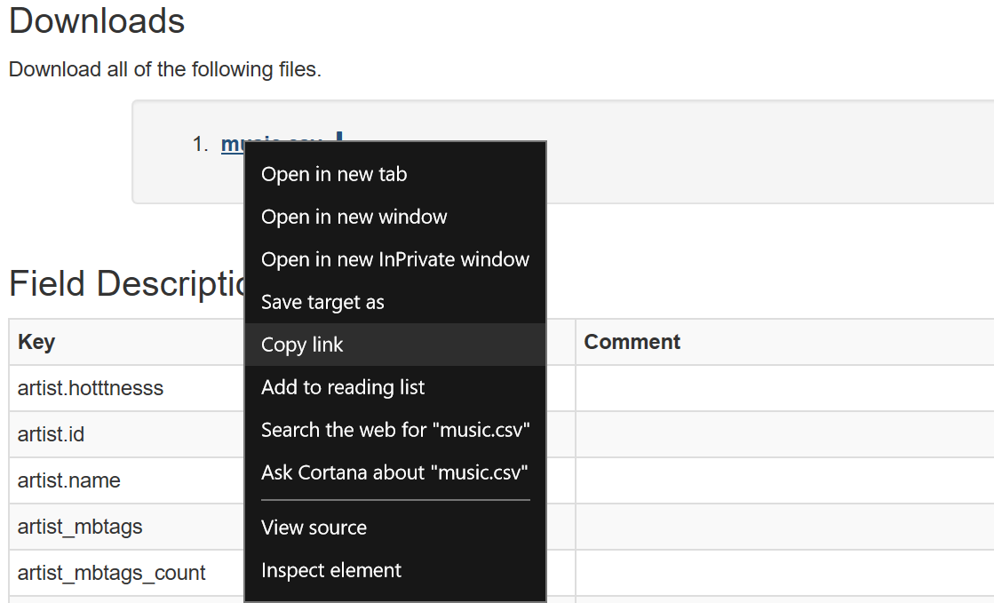
URL to R
Benefit: Don’t Need Data on PC
Problem: Links Change
Example

Slide 22
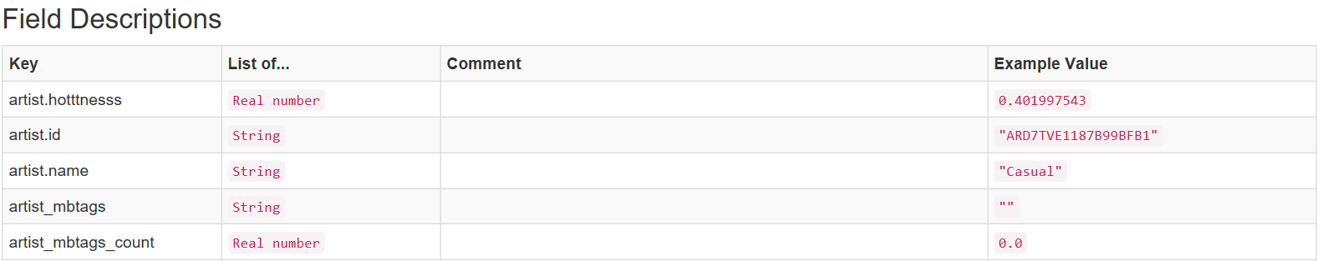
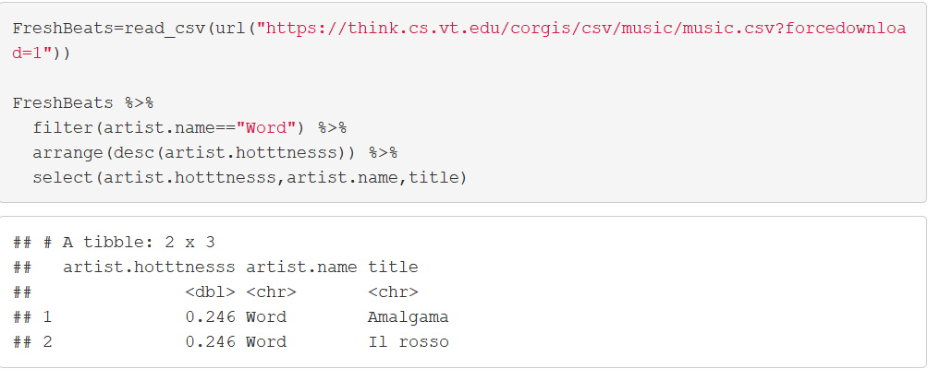
URL to R
Example

Slide 23
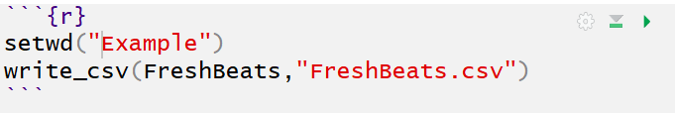
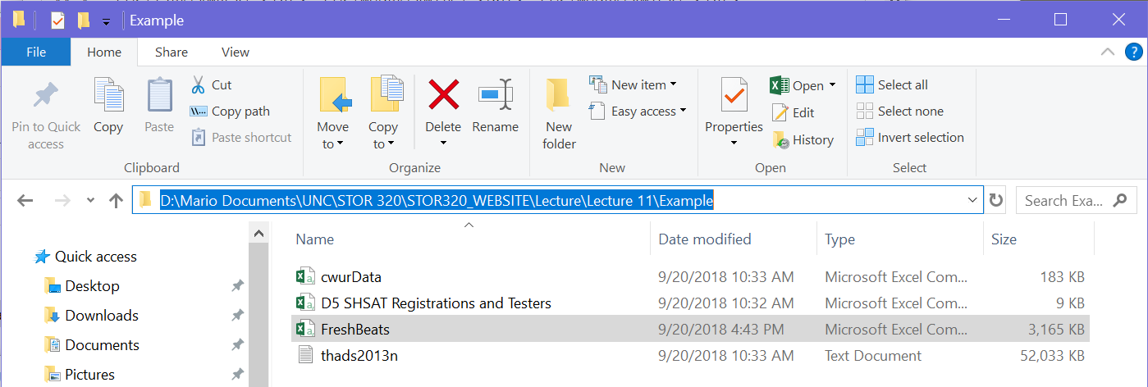
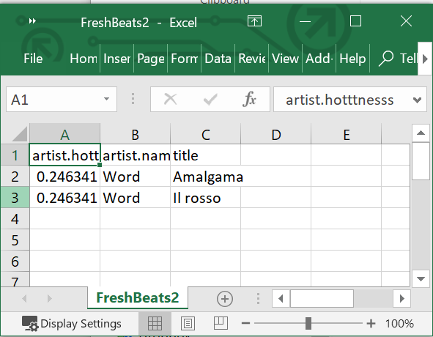
Writing Data
write_csv()
Saves R Tibble to Computer

Slide 24
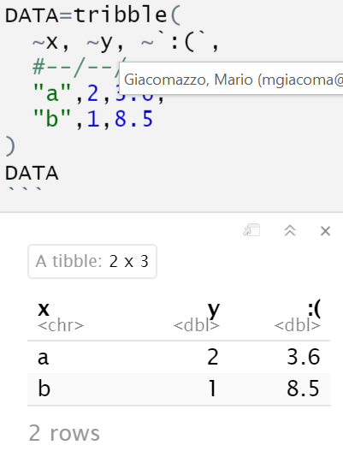
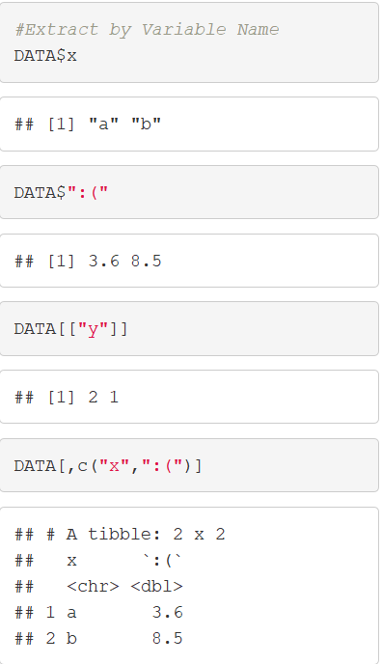
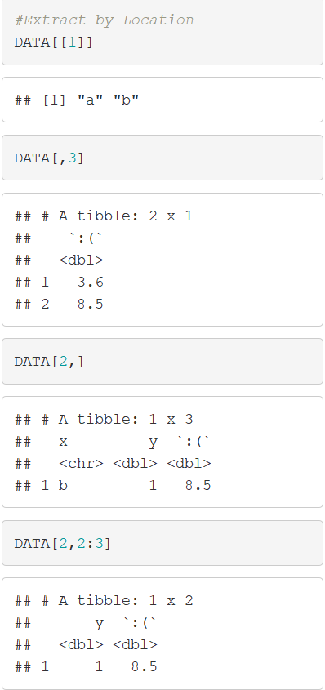
Tibbles and Bits
Read Chapter 7
Tibbles
Tribbles
Same Thing
Subsetting Info

Slide 25
Closing
Disperse and Make Reasonable Decisions

